Slide 1
Object Segmentation and Comparison
Xin Feng 82509956
Yitong Liu 50842989

Slide 2
Introduction
Object segmentation on a collection of images.
Compare and calculate the similarity of images with the reference images
Identifying whether a specific object present in the image

Slide 3
HSV Color Segmentation
Edge-Based Segmentation does not work with shadows and table edges
Threshold-Based Segmentation for images under the similar scenes
Separates color information from intensity or lighting.
Can construct a histogram or thresholding rules using only saturation and hue.
Notes:
We choose to use hsv color segmentation method to partition the original images into distinct objects.. Because it separates color information (chroma) from intensity or lighting (luma). Because value is separated, you can construct a histogram or thresholding rules using only saturation and hue. This in theory will work regardless of lighting changes in the value channel.

Slide 4
HSV Color Segmentation
Customize the range of colors to obtain the desired results
Control which colors are considered as part of the segmented region and which are not.

Slide 5
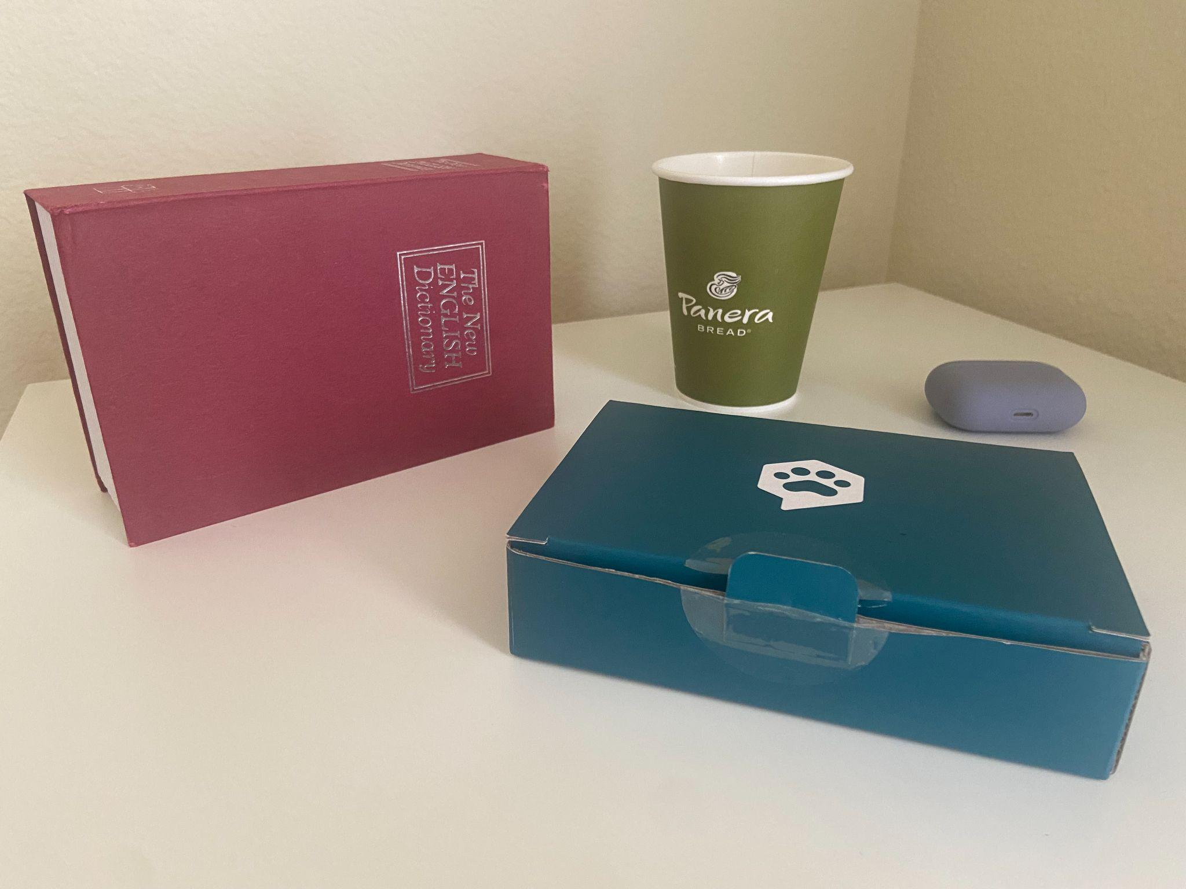
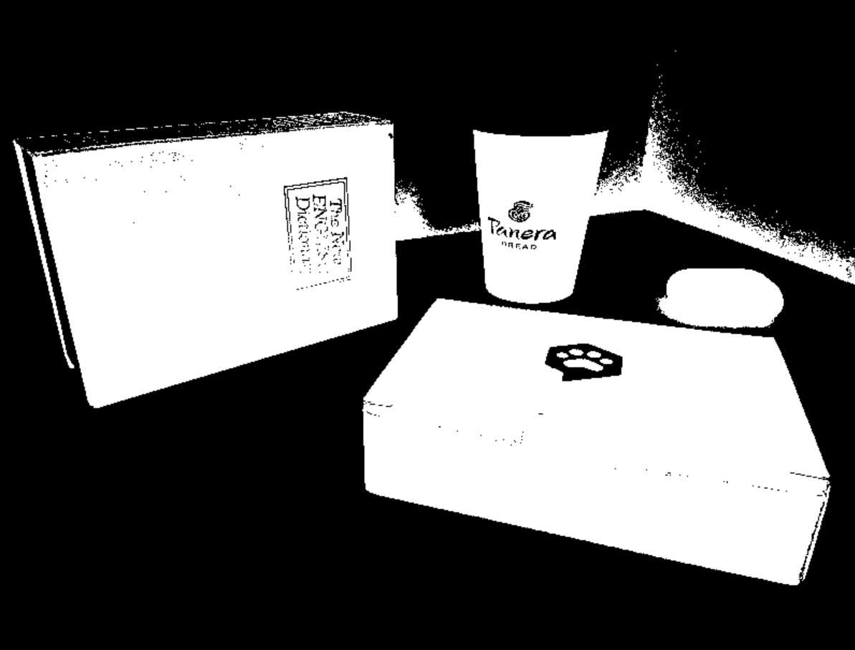

Slide 6
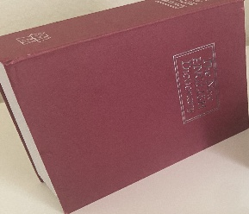
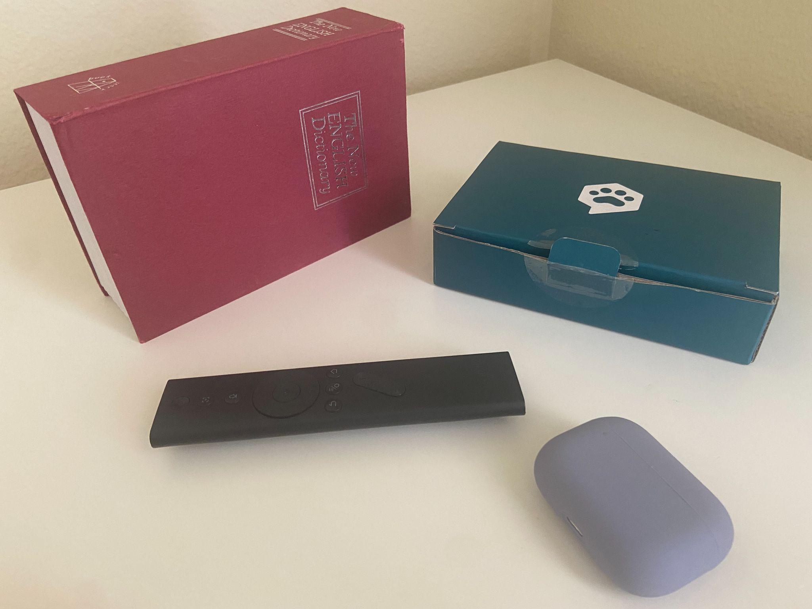
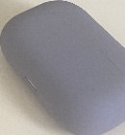
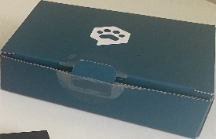

Resource picture
Result pictures
Notes:
Identify those objects by comparing them with our reference images

Slide 7
Dense Vector Representations
Due to variations in size and object transformations among the pictures we want to compare, we have decided to employ dense vector representations as a technique to determine whether they depict the same object.
For implementation purposes, we utilized the sentence-transformers library, which offers a convenient method for calculating dense vector representations specifically for images. In addition, we incorporated the OpenAI Contrastive Language-Image Pre-Training (CLIP) Model, a neural network that has already been trained on a diverse range of (image, text) pairs. This combination allowed us to effectively compute dense vector representations for images and leverage the power of CLIP's pre-training on multimodal data.

Slide 8
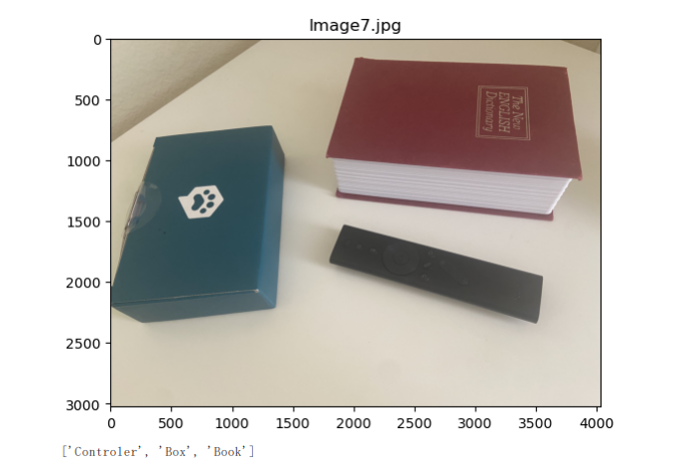
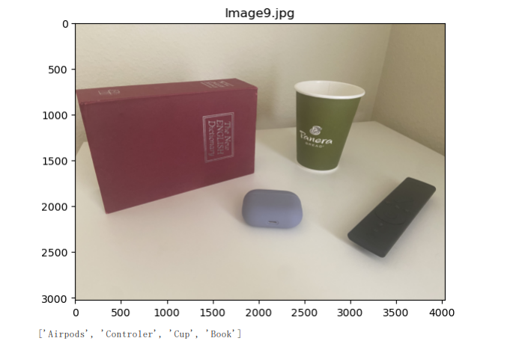
Pictures

Slide 9
Reference
https://stackoverflow.com/questions/69295962/drawing-bbox-for-realtime-object-detection-without-ml/69307887#69307887
https://medium.com/globant/maneuvering-color-mask-into-object-detection-fce61bf891d1
https://stackoverflow.com/questions/11541154/checking-images-for-similarity-with-opencv
https://stackoverflow.com/questions/16472716/why-is-color-segmentation-easier-on-hsv

